Slide 1
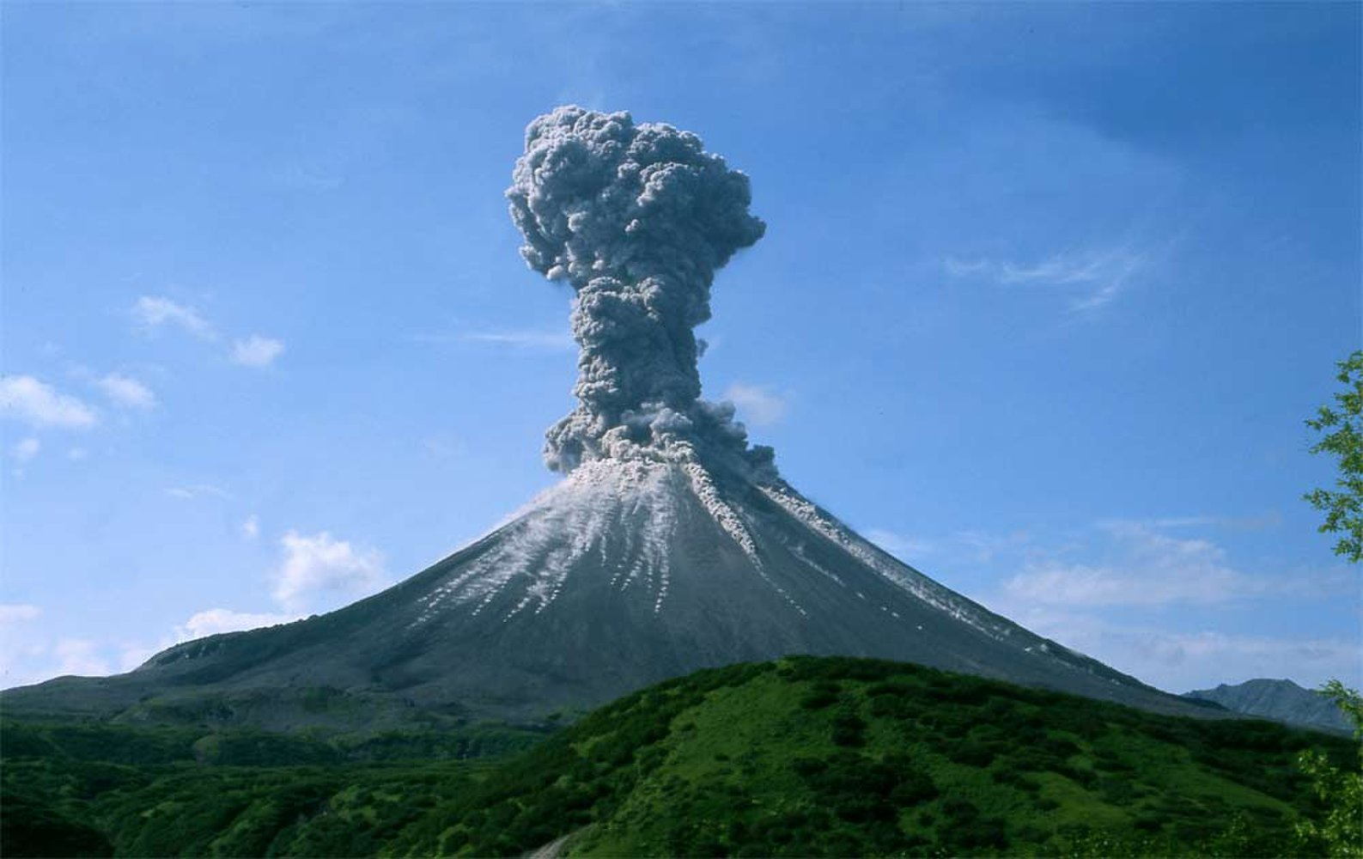

Chapter 14 The Internal Processes

Slide 2
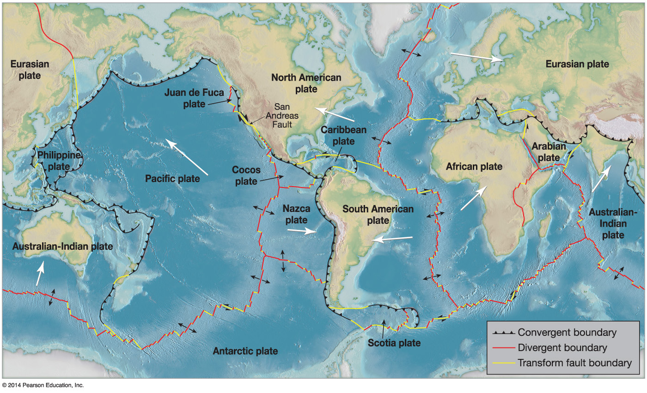

The Theory of Plate Tectonics
The tectonic plate boundaries

Slide 3

The Theory of Plate Tectonics
Plate tectonic theory
Theory behind motion of lithospheric plates
Plates float on asthenosphere
7 major plates, 7 intermediate plates, 12 smaller plates
Smaller plates are large plates that are being subducted
Driving plate tectonics
Slow convection in Earth’s mantle
Convection can push plates away from each other
Most motion results from plates pulled by subduction of dense oceanic lithosphere
Ongoing area of research

Slide 4
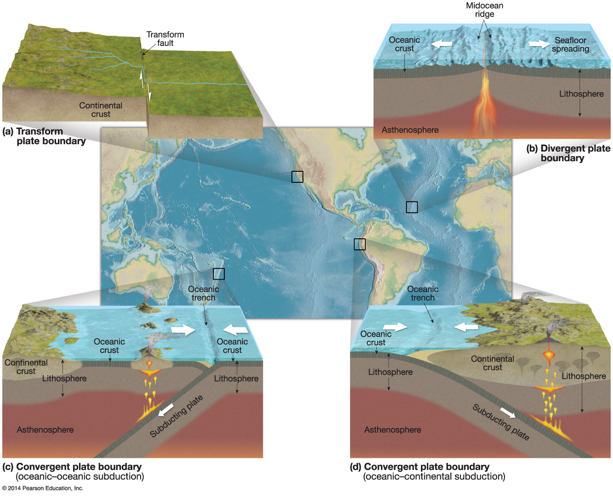

The Theory of Plate Tectonics
Major plate boundary types

Slide 5
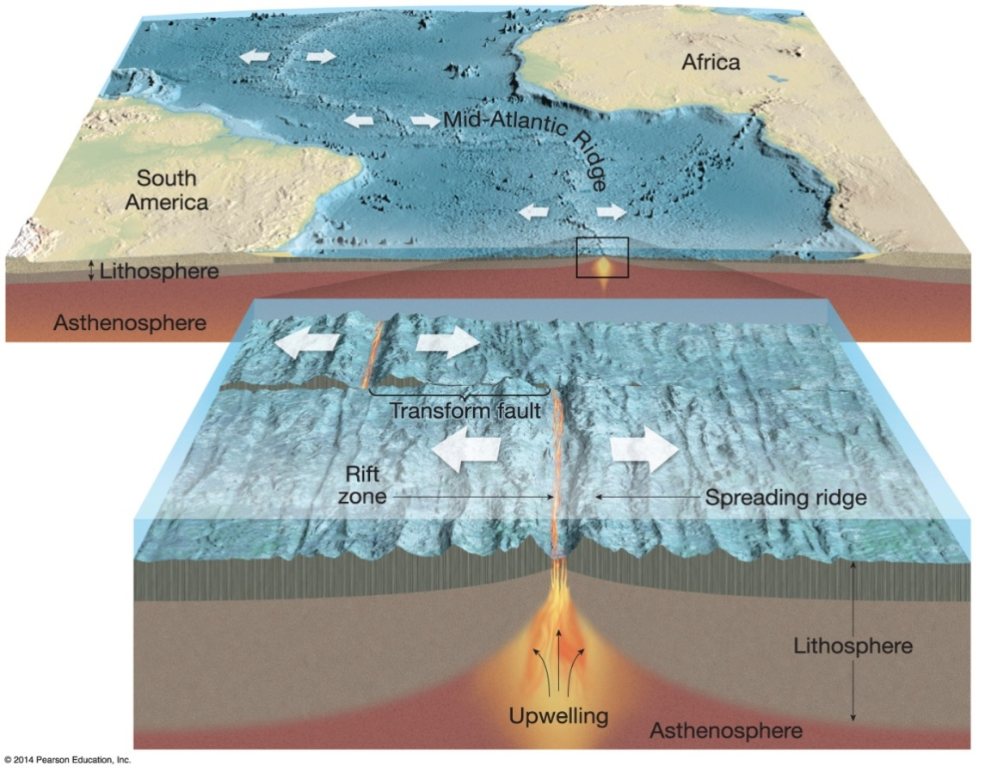

The Theory of Plate Tectonics
Plate boundaries
Divergent boundaries
Plates move away from each other
Asthenosphere wells up in the plate opening
Represented by a midoceanic ridge
Associated with shallow-focus earthquakes and volcanic activity
Constructive
Continental rift valley, proto-ocean

Slide 6

The Theory of Plate Tectonics
Plate boundaries (cont.)
Convergent boundaries
Collisions between plates
Destructive
Three primary collisions:
Oceanic–continental – oceanic plate sinks since more dense; subduction
Forms oceanic trench and continental mountains (e.g., Cascades, Andes)
Earthquakes occur along margin
Volcano formation along the plates – continental volcanic arc
Forms metamorphic rocks – blueschist (above)

Slide 7
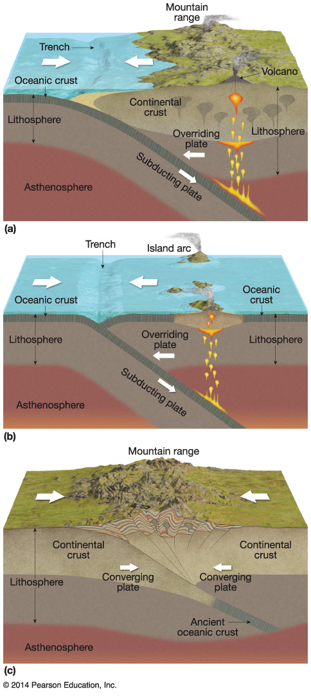

The Theory of Plate Tectonics
Plate boundaries (cont.)
Convergent boundaries (cont.):
Three primary collisions (cont.):
Oceanic–oceanic
Subduction results in undersea trench formation
Deep and shallow earthquakes
Island volcanic arc
Continental–continental
No subduction since two plates are highly buoyant
Builds huge mountain ranges
Volcanoes are rare
Shallow earthquakes are relatively common

Slide 8
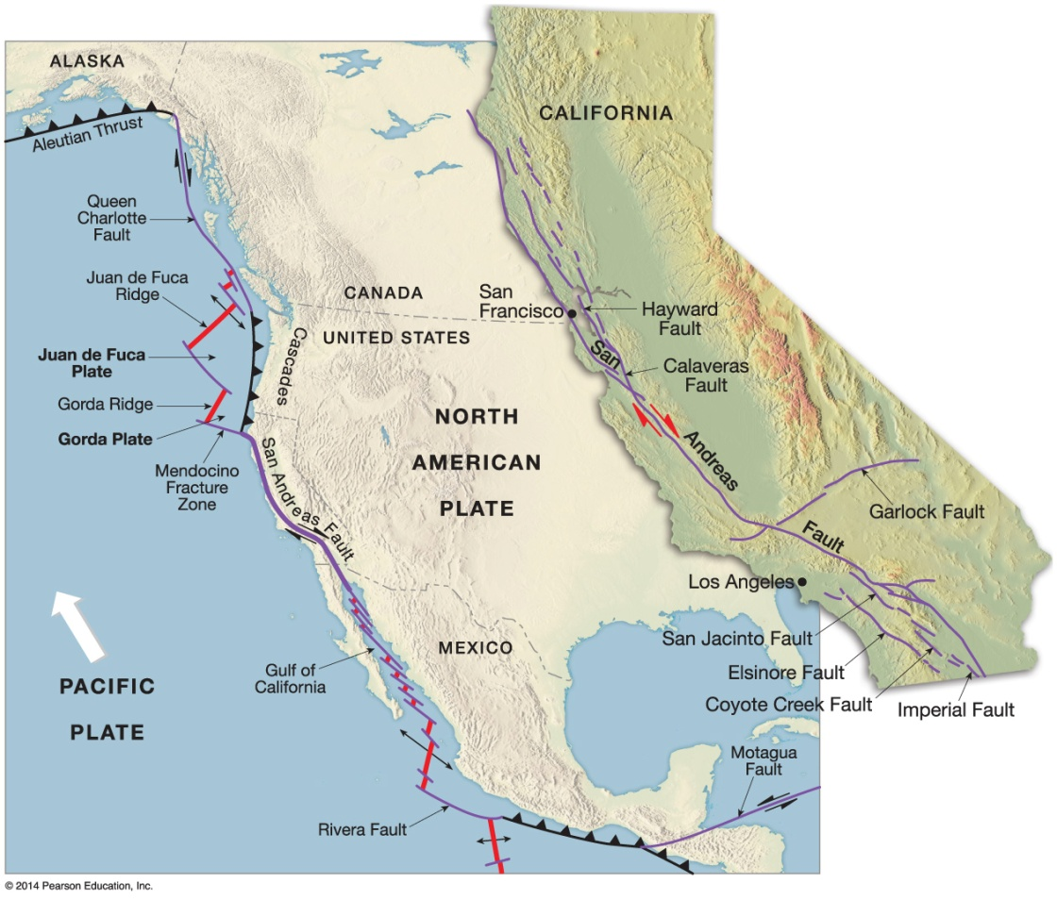

The Theory of Plate Tectonics
Plate boundaries (cont.)
Transform boundaries
Two boundaries slip past each other laterally
Transform faults
Neither creates nor destroys crust
Commonly produce shallow focus earthquakes
San Andreas fault

Slide 9
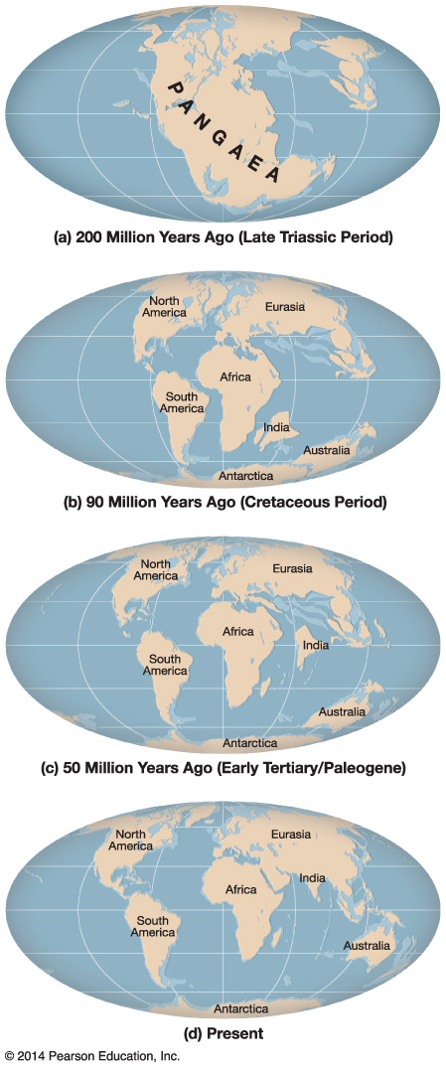

The Theory of Plate Tectonics
The rearrangement
450 million years ago, one supercontinent existed
Broke up 200 million years ago
Laurasia
Gondwanaland
Arrangement to the current continental configuration

Slide 10
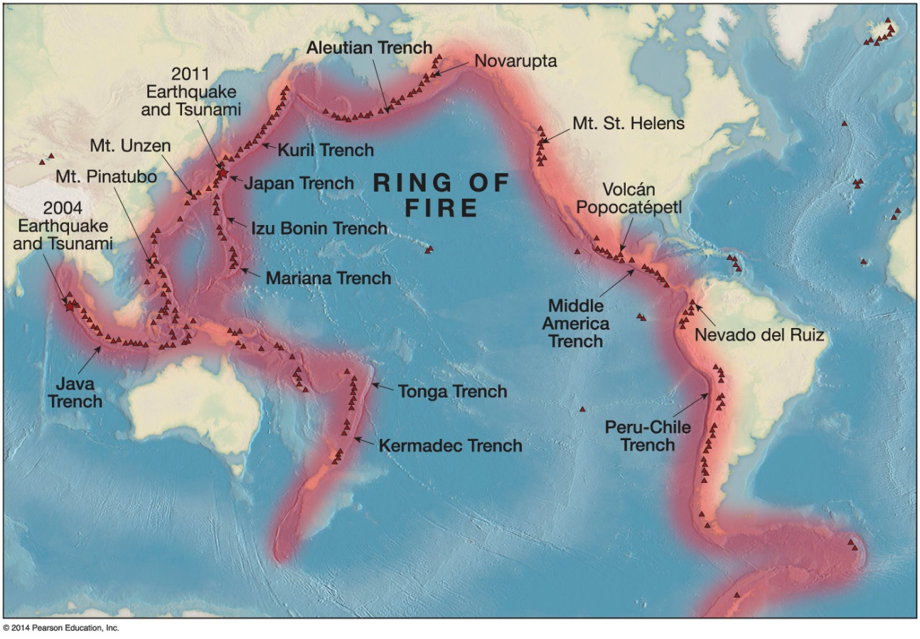

The Theory of Plate Tectonics
The Pacific Ring of Fire
Plate boundaries exist all around the Pacific Rim
Primarily subduction zones
75 percent of all volcanoes lie in the Ring of Fire

Slide 11
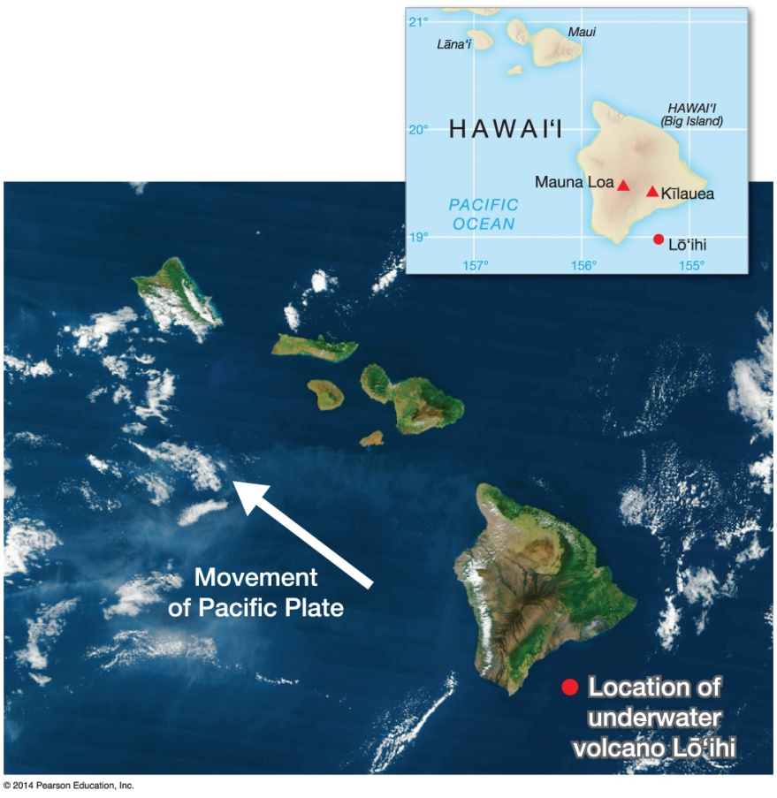
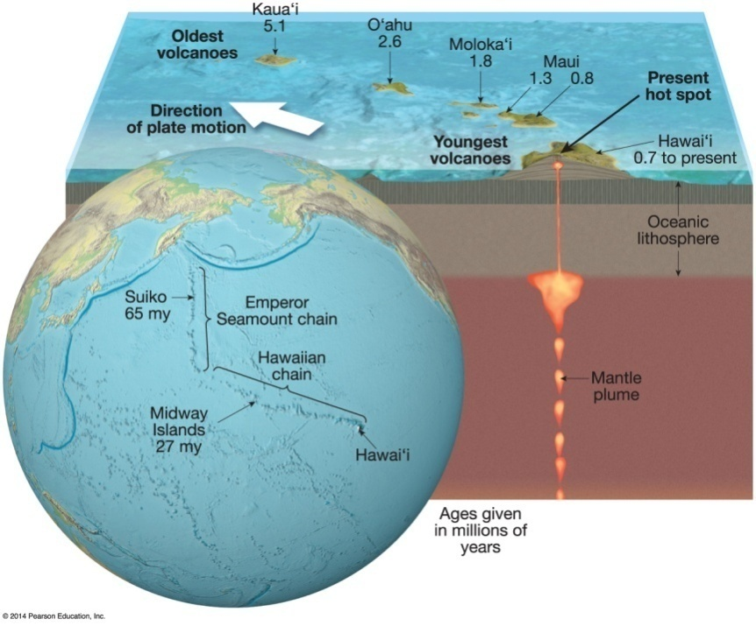

The Theory of Plate Tectonics
Additions to basic plate tectonic theory
Mantle plumes
localized hot areas not associated with plate boundaries
Move with the plate, so eventually become inactive
Hot spot trail
Hawaiian islands

Slide 12

Folding
Two primary types of diatrophism, folding and faulting
Results when rock is subjected to lateral compression
Can take place on any scale
Can vary in complexity
Two types
Anticline/upfold, can be forced to have reverse orientation, an overturned fold
Syncline/downfold – overthrust fold

Slide 13
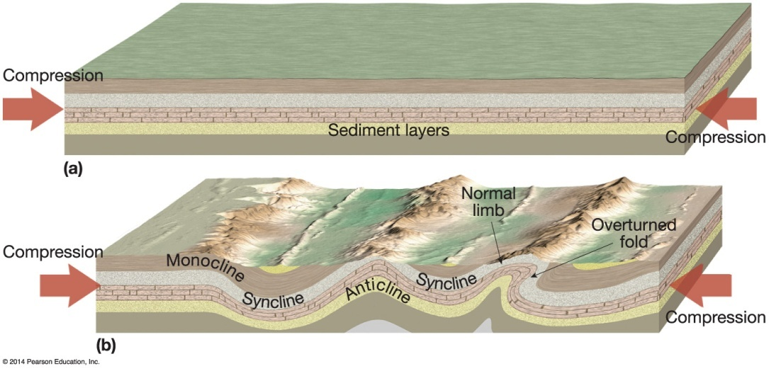
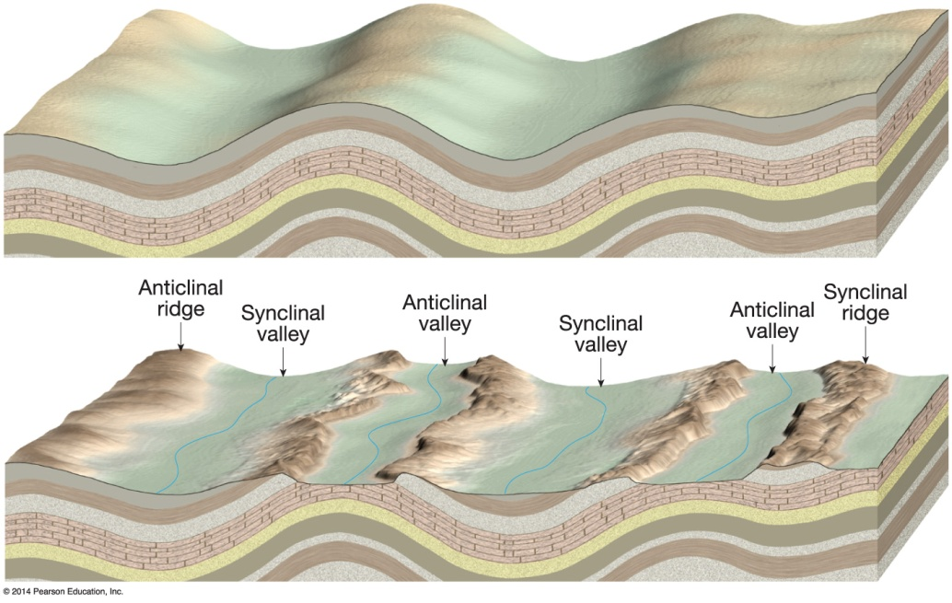

Folding
Examples of folding

Slide 14
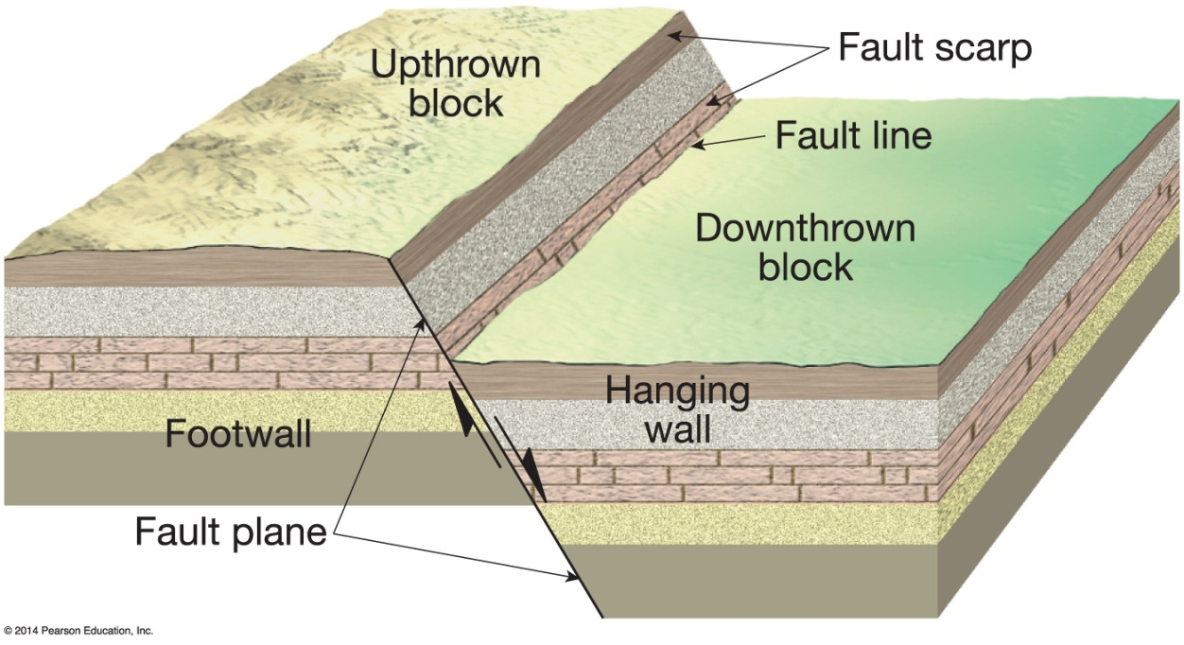

Faulting
Occurs when rock breaks accompanied by displacement
Occurs along zones of weakness in the crust, fault zones
Fault lines
Begin as sudden ruptures, but can result in large (hundreds of km) faults over millions of year
Fault scarps

Slide 15
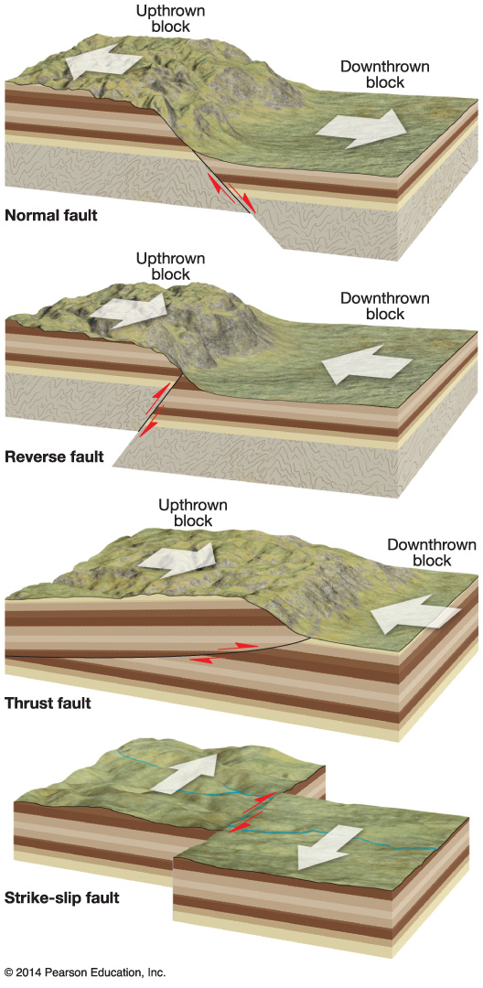
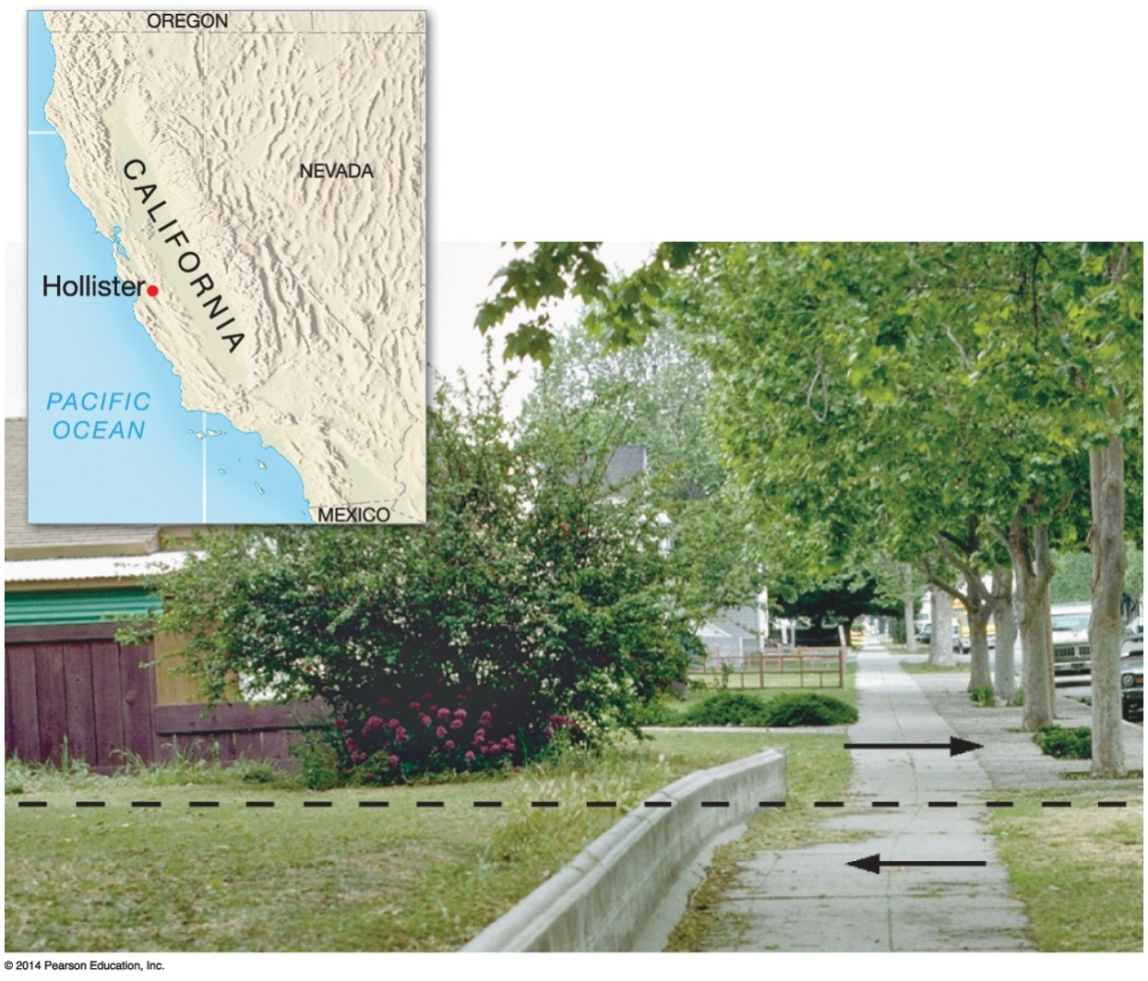

Faulting
Four primary fault types
Hanging wall

Slide 16
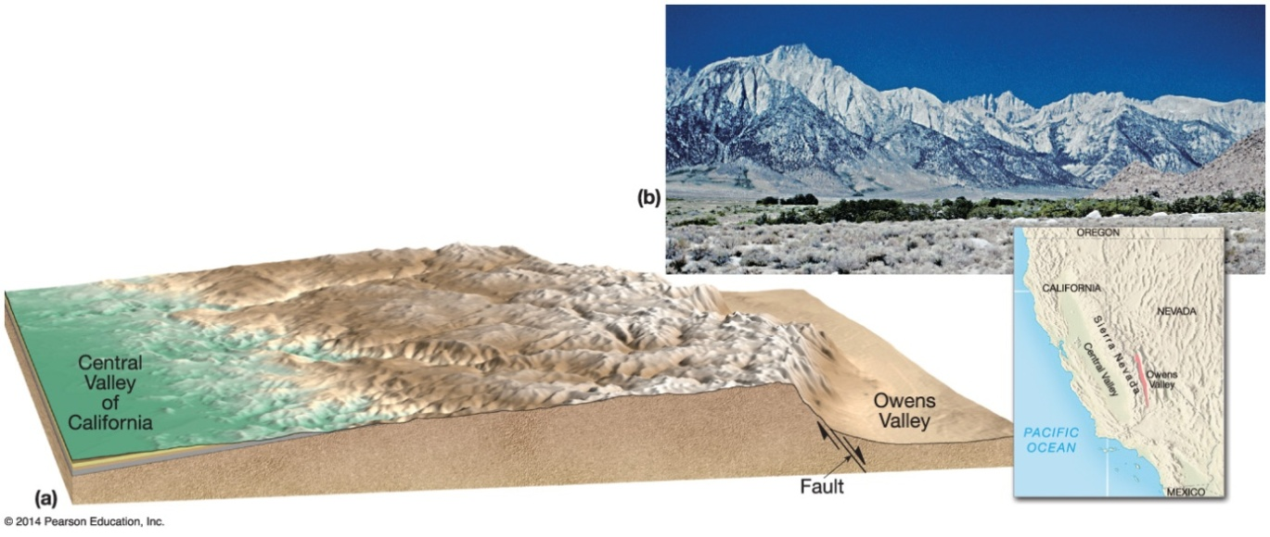
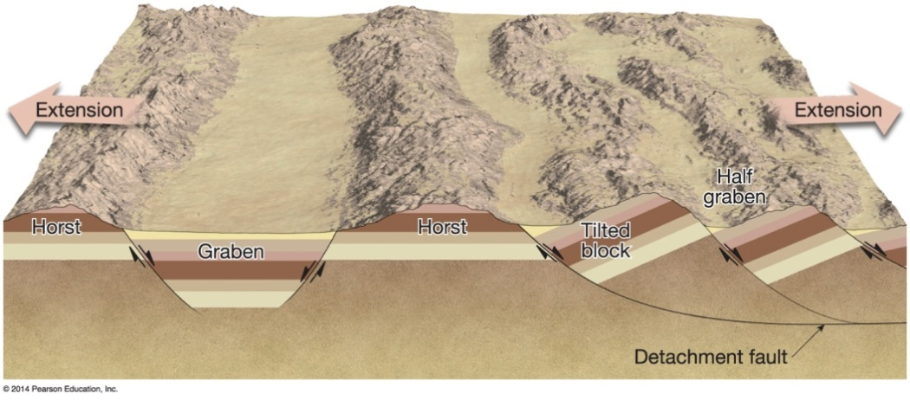

Faulting
Fault-produced landforms
Tilted fault-block mountains; one side of the fault block is tilted steeply relative to the other
Horst – uplift of a land block between two parallel faults
Graben – downthrown land block between two parallel faults

Slide 17
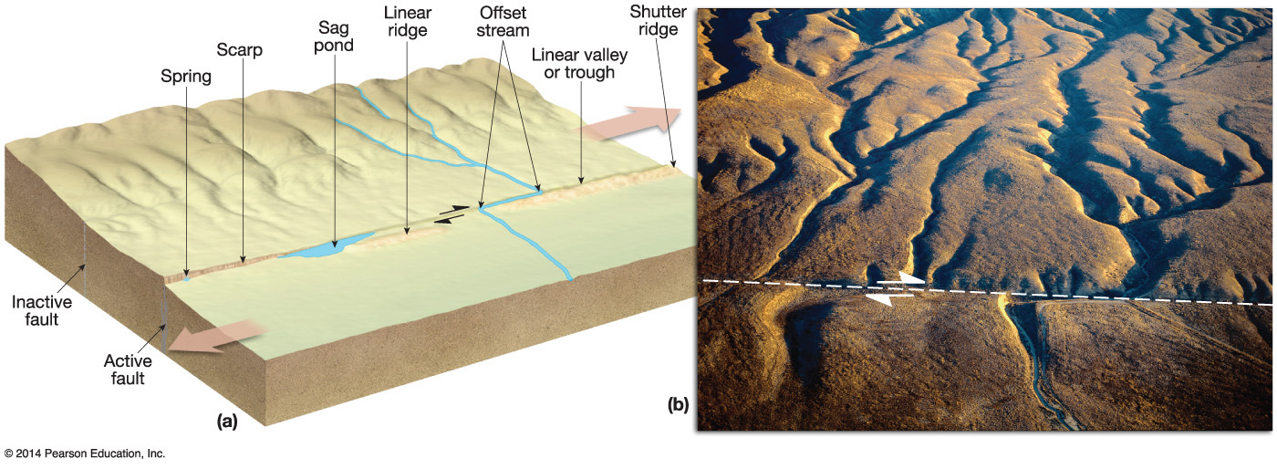

Faulting
Strike-slip faulting landforms
Linear fault trough
Small depressions in the trough known as sags
Sag ponds
Offset drainage channels
Shutter ridge

Slide 18
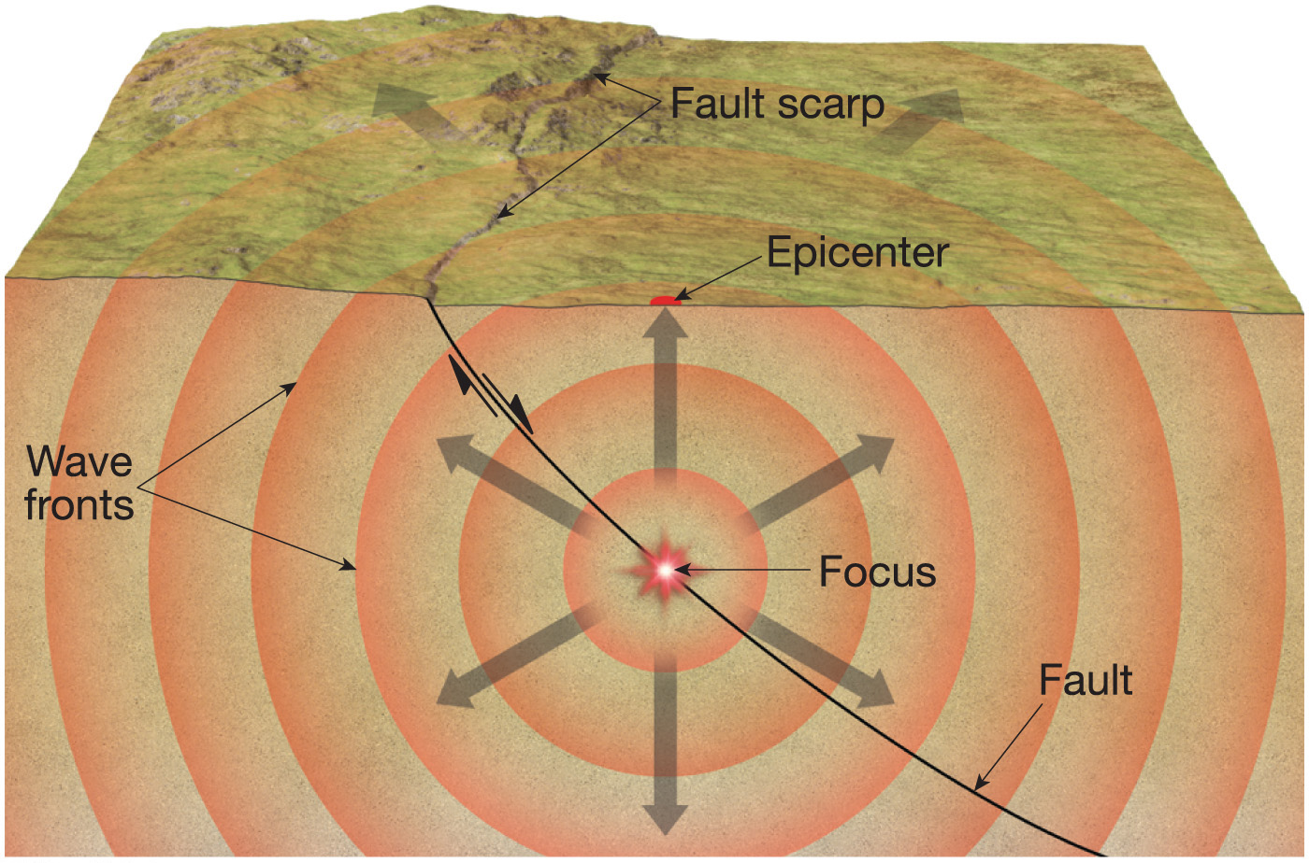

Notes:
Chapter 14, Figure 14.63 Labeled

Slide 19
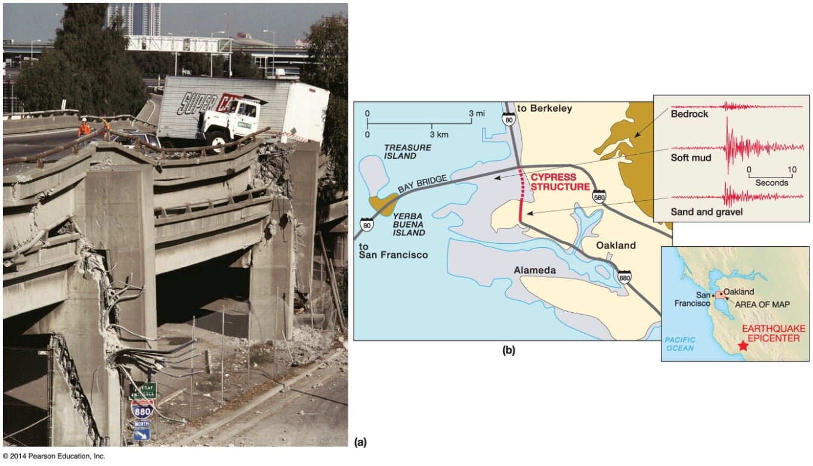

Faulting
Earthquake hazards
Most damage from ground shaking
Liquefaction of moist sediments
Landslides
Water movements in lakes and oceans (e.g., tsunamis)

